Slide 1

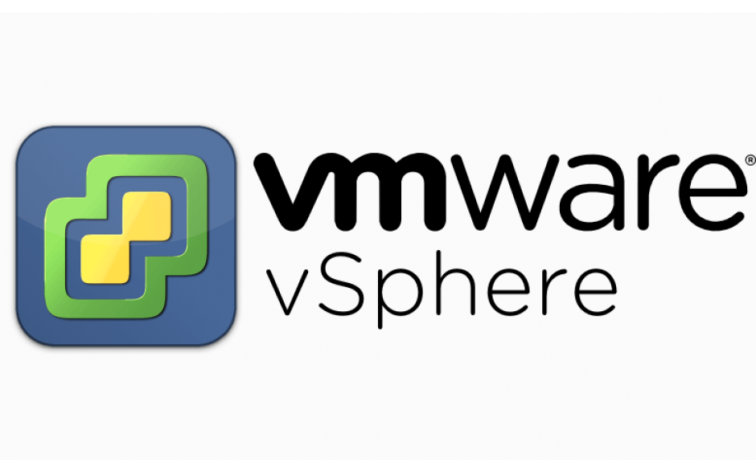

Slide 2
What is vSphere?
VMware vSphere is the brand name for VMware's suite of
virtualization products.
It includes:
VMware ESXi
VMware vCenter Server
vSphere vMotion
vSphere High Availability (HA)
vSphere Distributed Resource Scheduler (DRS)
And more..

Slide 3
VMware ESXi.
VMware ESXi (formerly ESX) is an enterprise-class, type-1 hypervisor developed by VMware for deploying and serving virtual computers. As a type-1 hypervisor, ESXi is not a software application that one installs in an operating system (OS); instead, it includes and integrates vital OS components, such as a kernel.
ESX originated as an abbreviation of Elastic Sky X

Slide 4
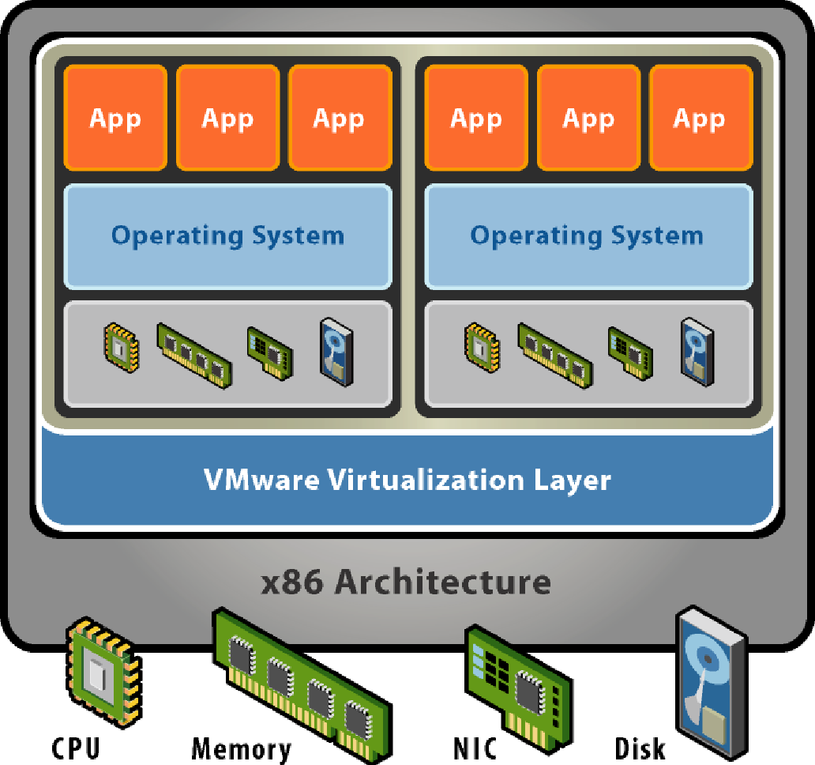
Architecture

Slide 5
vSphere vCenter and vClient.
vCenter Server provides centralized management of virtualized hosts and virtual machines from a single console. It gives administrators deep visibility into the configuration of the critical components of a virtual infrastructure—all from one place.
IT administrators can ensure security and availability, simplify day-to-day tasks, and reduce the complexity of managing virtual infrastructure.
vClient is used to connect to vcenter server.

Slide 6
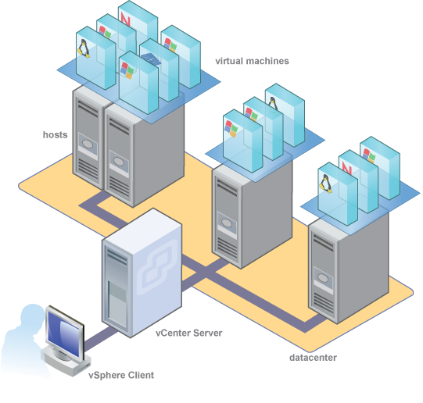

Slide 7
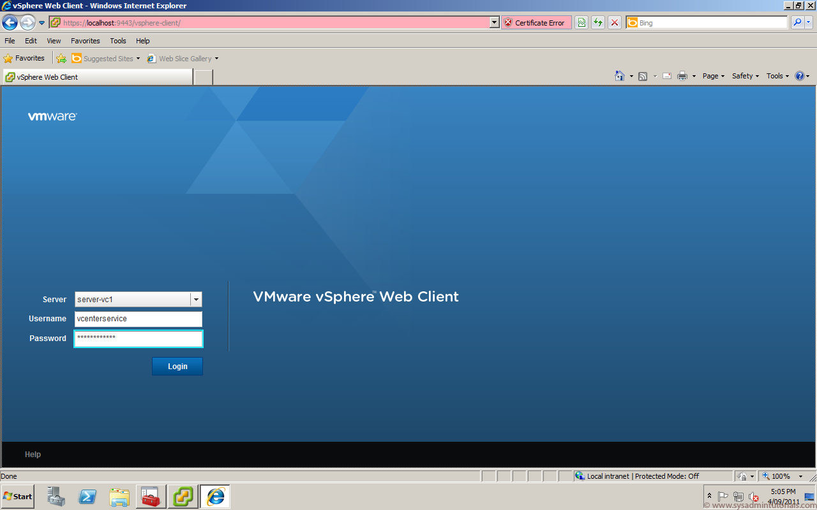

Slide 8
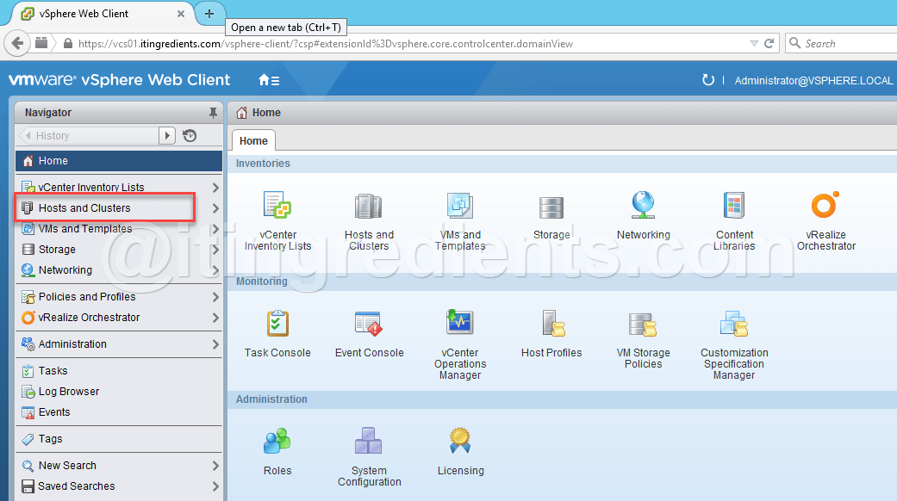

Slide 9
Benefits of vSphere.
Analyze and remediate issues quickly with visibility into vSphere virtual infrastructure.
• Deliver the security and availability of vSphere through automated proactive management features such as automated load balancing and out-of-the-box automation workflows.
• Extend virtualization capabilities using thirdparty ecosystem solutions.
• Solve problems faster with best in class VMware Log Management

Slide 10
vSphere vMotion
VMware VMotion enables the live migration of running virtual machines from one physical server to another with zero downtime and continuous service availability.
The virtual machines will be migrated while the first vm is running on the source machine.
The user is unaware that their live vm is being migrated to another resource.

Slide 11
Benefits of vmotion
Can move vm from one host to another quickly with a click of button. No need to copy the whole vm into a portable storage device(cds,pendrives ,hardisks etc) and paste it into another host.
The services provided by the vm need not be interrupted if its host is under maintenance.

Slide 12
How does vMotion work?
The first step is to ensure that the source VM can be operated on the chosen destination server.
Then a second VM process is started on the target system and the resources are reserved.
Next a system memory checkpoint is created. This means all changes to the source VM are written to an extra memory area.
The contents of the system memory recorded at the checkpoint are transferred to the target VM.
The checkpoint/checkpoint-restore process is repeated until only the smallest changesets remain in the target VM’s memory.
The CPU of the source VM is stopped.
The last modifications to the main memory are transferred to the target VM in milliseconds.
The vMotion process is ended and a reverse ARP packet is sent to the physical switch (important: Notify Switches must be activated in the properties of the virtual switch). Hard disk access is taken over by the target ESX.
The vMotion process is ended and a reverse ARP packet is sent to the physical switch (important: Notify Switches must be activated in the properties of the virtual switch). Hard disk access is taken over by the target ESX.

Slide 13
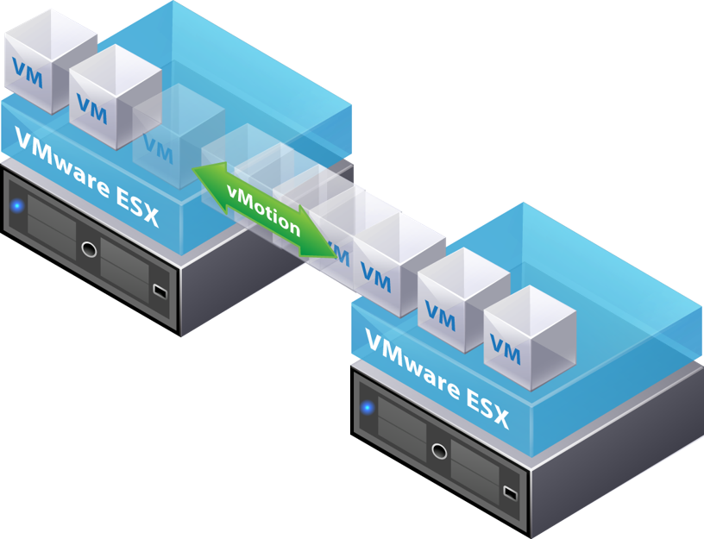

Slide 14
vSphere High Availability (HA)
What is it?
Providing higher levels of availability for VM’s.
Confidence for businesses.
Allows for:
Protection of Tier1 Application
Restart of VM upon application failure
VM high availability
Virtual machine health monitoring
Host high availability
Host monitoring
Zero downtime VM recovery upon host failure

Slide 15
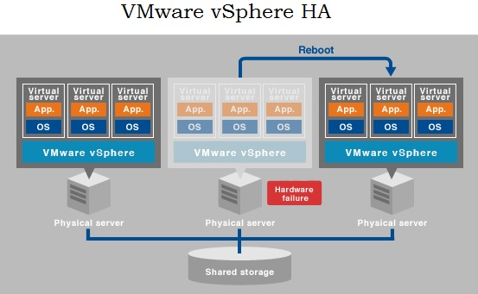
Hosts in the cluster are monitored and in the event of a failure, the virtual machines on a failed host are restarted on alternate hosts.

Slide 16
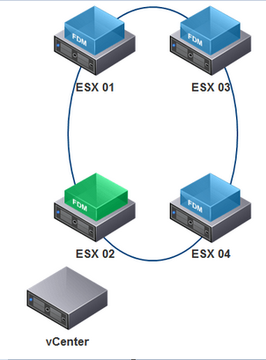
vSphere HA Primary Components
Every host runs an agent
Referred to as ‘FDM’ or fault domain manager
One of the agents within the cluster is chosen to assume the role of the master
There is only one Master per cluster during normal operations
All other agents assume the role of Slaves.

Slide 17
The Master Role
An FDM master monitors:
ESX hosts and Virtual Machine availability.
All slave hosts. Upon a Slave host failure, protected VMs on that host will be restarted.
The power state of all the protected VMs upon failure of a protected VM, the master will restart it.
An FDM master also manages the list of hosts that are members of the cluster.

Slide 18
The Slave Role
A slave monitors the state of its locally running VMs and forwards any significant state changes the Master.
It implements vSphere HA features by VM Health Monitoring.
It Monitor the health of the Master.
Maintains the list of powered on VMs.

Slide 19
The Master Election Process
The Master is determined through a election process.
A election occurs when:
vSphere HA is enabled.
A master host fails.
If in case slave does not receive any network heart beat.
The following algorithm is used for selecting the master:
The host with access to the greatest number of datastores wins.
In a tie, the host with highest moid is chosen.
-(Agent Communication)

Slide 20
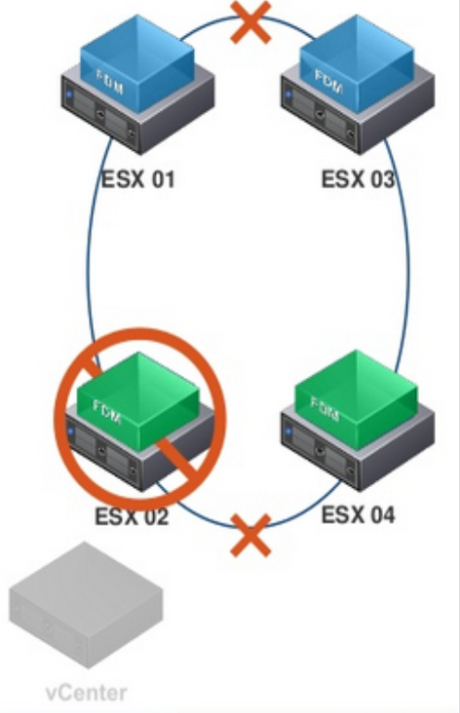
Protectedlist File
On selection of the master, it will acquire ownership of datastores that it can directly access through management network by locking a file called “Protectedlist File”.
What happens if master fails?
The lock will expire, new master will
relock the file.
- Master will release the lock from the
file in the datastore.

Slide 21
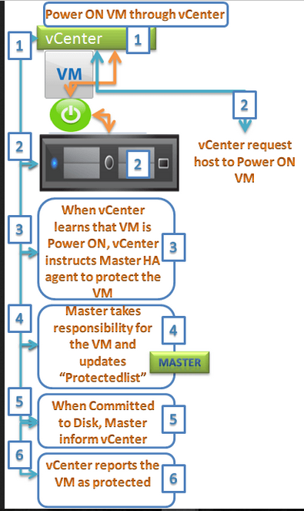
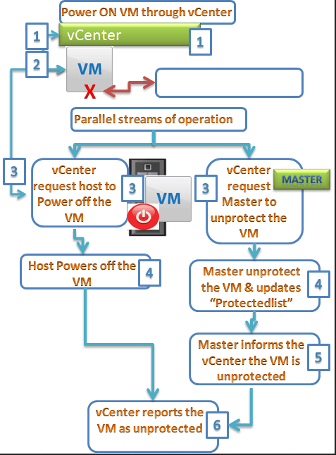
VM Protection
VM Protection
VM Unprotected

Slide 22
VM protection and unprotected both must be updated on protectedlist file.
When the state of VM changes, vCenter server will direct the master to protect or unprotect the VM

Slide 23
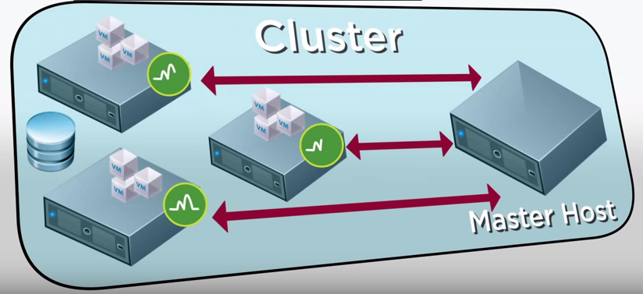
The master host can detect host failures or isolation by monitoring for network heartbeats from each host every second.

Slide 24
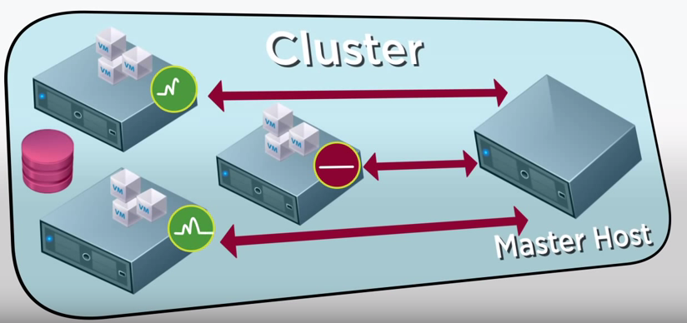
If it does not get a heartbeat, it determines if the host is heartbeating to one of the cluster’s datastores.

Slide 25
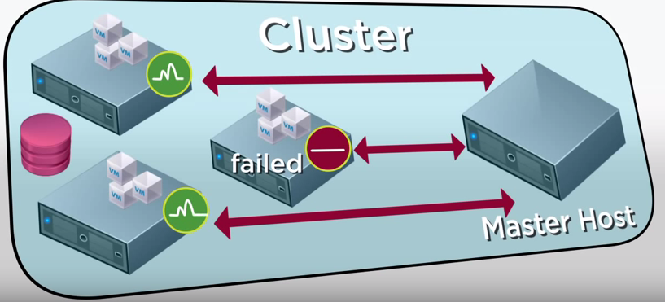
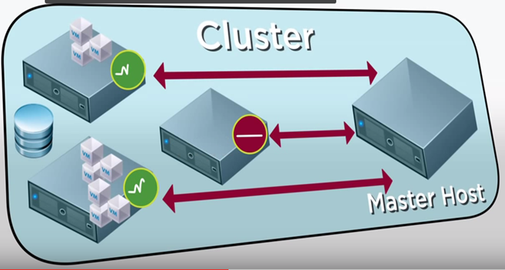
If not, the host is considered to have failed and HA restarts its virtual machines on alternate host.

Slide 26
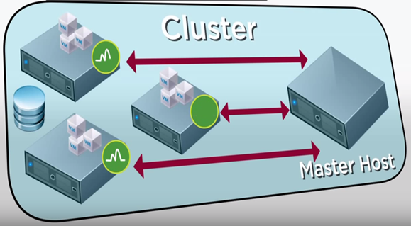
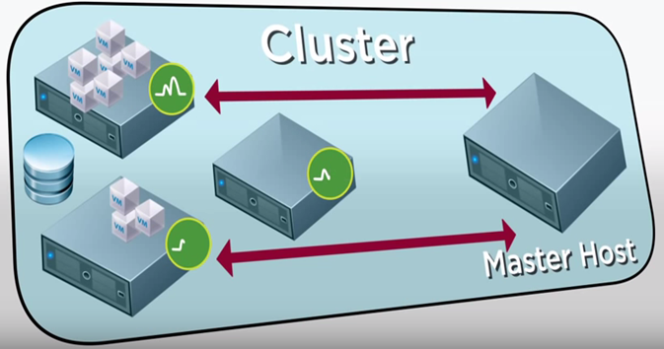
But if the host is still heartbeating with a datastore, it might only be network isolated. This means that it is still running but cannot observe the vSphere HA management network. In this case, the master host continues to monitor the VMs and if they power off, restarts then on another host.

Slide 27
What is VMware DRS?
Distributed Resource Scheduler (DRS) aggregates computing capacity across a collection of servers into logical resource pools. It intelligently allocates available resources among the virtual machines based on pre-defined rules that reflect business needs and changing priorities.

Slide 28
What is DPM?
Distributed power management(DPM) is a new feature of Vmware DRS that continuously monitors resource requirements in a Vmware DRS cluster.
Resource requirements of the cluster decreases during periods of low usage.
Resource requirements of workloads increase during period of higher usage.
Vmware DPM allows IT organisations to:
Cut power and cooling costs in the datacenter.

Slide 29
How does VMware DRS work?
Aggregates computing capacity
Virtual machine experiences increased load
Migrating it to another server.
Making more space for it on the same server.
Migration is transparent to end users
VMware DRS can be configured to operate in either automatic or manual mode.

Slide 30
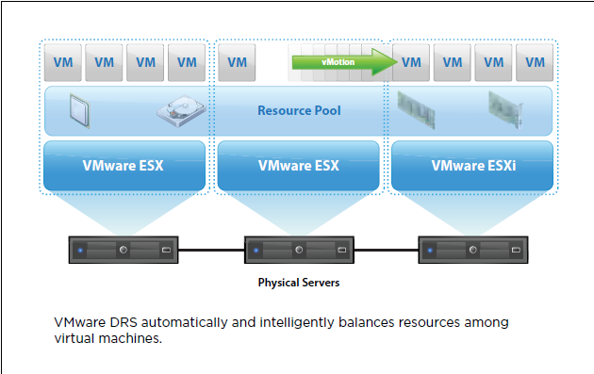

Slide 31
How does VMware DPM Work?
It makes recommendation to power off or power on hosts.
Available capacity in a DRS cluster against resource requirements of VMs.
It detects that there are too many hosts powered on
Consolidate VMs onto fewer hosts and power off the remaining.
Bring powered off hosts online

Slide 32
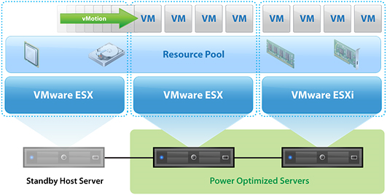
Vmware DPM automatically powers off physical servers to reduce power consumption in datacenters.

Slide 33
How is Vmware DRS Used in the Enterprise?
Customer’s use Vmware DRS to:
Dramatically increase system administrator productivity.
Manage a large pool of infrastructure resources.
Automate hardware maintenance.
Easily add and deploy new capacity.
Reduce power consumption in the datacenter automatically.

Slide 34

CASE STUDY - ACI SPECIALITY BENEFITS
ACI SPECIALITY BENEFITS is US based company which provides .The company offers employee assistance programs. It also provides workspace wellness and student assistance programs.

Slide 35
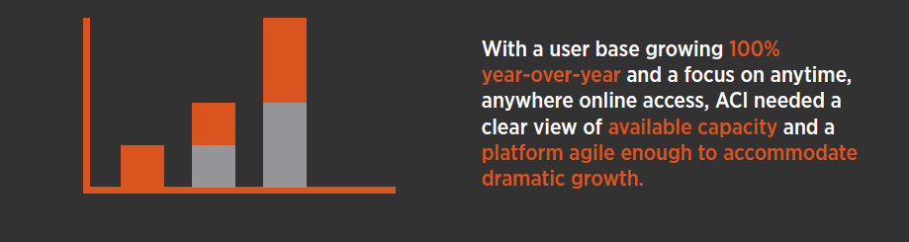
Problem.

Slide 36
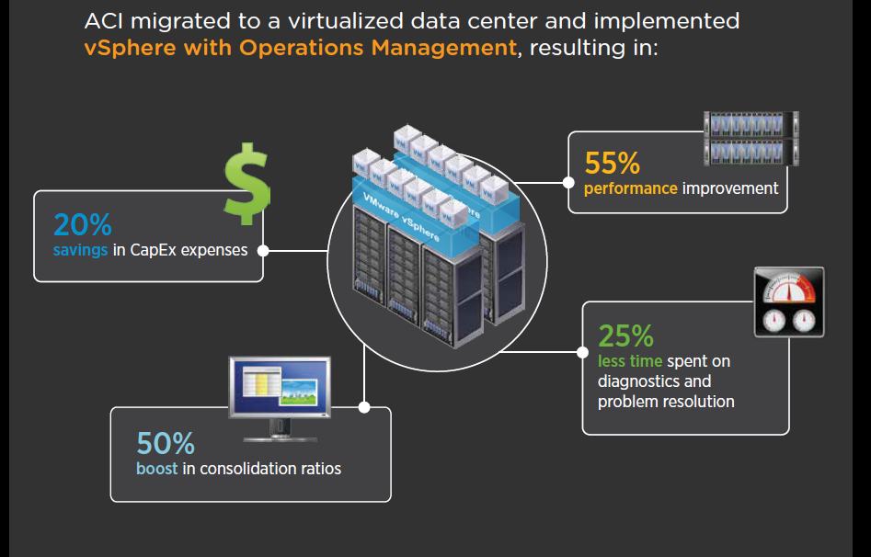

Slide 37
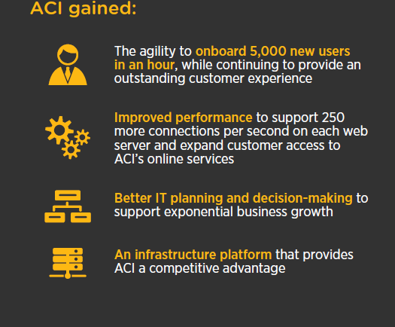
BENEFITS

Slide 38
Thank you!

